Slide 1
Running GenAI on Intel AI Laptops and Simple LLM Inference on CPU and fine-tuning of LLM Models using Intel® OpenVINO™”
Name: Kuruganti Shanmukha Thrisha
College: Kommuri Pratap Reddy Institute of Technology
Department: CSE

Slide 2
TITLE:
Hand Script VINO: Enhanced Handwritten OCR with Open VINO Acceleration

Slide 3
PROBLEM STATEMENT:
Handwritten text recognition remains a significant challenge in the field of computer vision and machine learning. While printed text OCR has achieved high accuracy, handwritten OCR faces variability in handwriting styles, diverse languages, and various noise factors. Accurate recognition of handwritten text is crucial for digitizing historical documents, automating data entry, improving accessibility, and enhancing digital archiving.
Develop an OCR system capable of accurately recognizing and converting handwritten text from images into machine-readable text. The system should be robust against variations in handwriting styles, noise, and image quality, and should support multiple languages and scripts.

Slide 4
UNIQUE IDEA (BRIEF SOLUTION):
Develop a handwritten OCR system tailored for personalized learning environments. This system would not only recognize and digitize handwritten notes but also analyze the handwriting style, speed, and patterns to provide insights into the student’s learning process. By integrating machine learning algorithms, the system can adapt to individual handwriting styles over time, improving accuracy and efficiency. Additionally, it can offer feedback on handwriting legibility and suggest improvements, making it a valuable tool for both students and educators. This approach can enhance remote learning experiences, support students with dysgraphia, and provide a more interactive and engaging way to track and improve handwriting skills.

Slide 5
Features Offered:
Handwritten OCR (Optical Character Recognition) systems offer a variety of advanced features to enhance the accuracy and usability of digitized handwritten text. Here are some key features:
1.High Accuracy Recognition:
Advanced algorithms and machine learning models improve the accuracy of recognizing diverse handwriting styles, including cursive and manuscript
2.Language Support:
Many systems support multiple languages, making them versatile for global use
3.Real-Time Processing:
Some OCR systems can process handwritten text in real-time, providing immediate feedback and digitization1
4.Image Augmentation:
Techniques like ThickOCR, ThinOCR, Elongate OCR, and Line Erase OCR enhance the quality

Slide 6
and readability of handwritten text .
5.Integration with Other Tools:
Handwritten OCR can integrate with other software, such as document management systems, to streamline workflows and improve productivity
6.Searchable Text Conversion
Converts handwritten notes into searchable text, allowing users to easily find and organize information
7.Annotation and Editing:
Offers options to annotate and edit the digitized text, making it more interactive and useful for various applications
8.Personalized Learning Insights:
Analyzes handwriting patterns to provide insights into learning habits and suggest improvements, beneficial for educational purposes

Slide 7
Process flow:
The process flow in a handwritten OCR (Optical Character Recognition) system typically involves several key steps to accurately recognize and digitize handwritten text. Here’s a brief overview of the process:
1.Image Acquisition:
Capture the handwritten text using a scanner or camera. The quality of the image is crucial for accurate recognition.
2.Preprocessing:
Noise Reduction: Remove any noise or distortions from the image to enhance clarity.
Binarization: Convert the image to a binary format (black and white) to simplify the recognition process.
Normalization: Adjust the size and orientation of the text to a standard format.

Slide 8
3.Segmentation:
Line Segmentation: Separate the text into individual lines.
Word Segmentation: Further divide the lines into individual words.
Character Segmentation: Finally, segment the words into individual characters.
4.Feature Extraction:
Extract relevant features from each character, such as edges, strokes, and loops, which are essential for recognition.
5.Recognition:
Character Recognition: Use machine learning models, such as Convolutional Neural Networks (CNNs) or Recurrent Neural Networks (RNNs), to recognize individual characters.
Word Recognition: Combine recognized characters to form words, often using language models to improve accuracy.

Slide 9
7.Post-Processing:
Spell Checking: Correct any spelling errors in the recognized text.
Contextual Analysis: Use context to improve the accuracy of the recognized text, such as correcting homophones based on sentence context.
8.Output:
Convert the recognized text into a digital format, such as a text file or a searchable PDF.

Slide 10
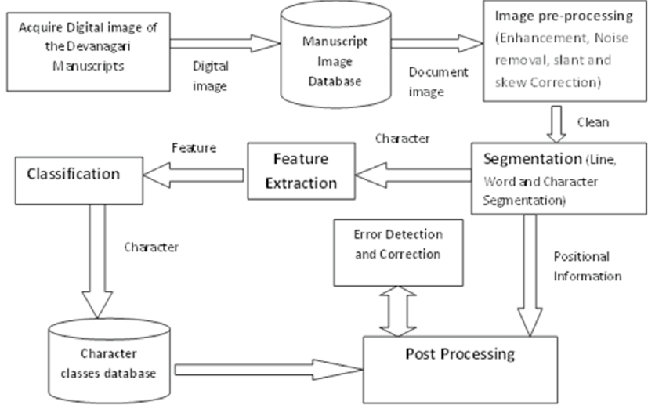
ARCHITECTURE DIAGRAM:

Slide 11
TECHNOLOGIES USED:
1.Machine Learning and Deep Learning:
Transformer Models: Advanced models like transformers are increasingly used for their ability to handle long-range dependencies and improve recognition accuracy.
2. Image Processing Techniques:
Binarization: Converts grayscale images to binary images to simplify the recognition process.
Noise Reduction: Removes noise and enhances image quality to improve recognition accuracy.
Normalization: Standardizes the size and orientation of the text.
3.Natural Language Processing (NLP):
Language Models: Used to improve the accuracy of word recognition by considering the context of the text.

Slide 12
CONCLUSIONS:
Handwritten OCR (Optical Character Recognition) has made significant strides in recent years, leveraging advanced technologies such as machine learning, deep learning, and natural language processing. These advancements have greatly improved the accuracy and efficiency of recognizing and digitizing handwritten text, making it a valuable tool in various fields
Key Takeaways:
Technological Advancements:
The integration of Convolutional Neural Networks (CNNs), Recurrent Neural Networks (RNNs), and Transformer models has enhanced the ability to accurately recognize diverse handwriting styles.
Image processing techniques like binarization, noise reduction, and normalization play a crucial role in preparing handwritten text for recognition.

Slide 13
3.Applications:
Handwritten OCR is widely used in document management, educational tools, and personal note-taking, converting handwritten notes into searchable and editable digital formats.
It supports multiple languages, making it versatile for global use.
4.Challenges and Future Directions:
Despite significant progress, challenges remain in accurately recognizing highly variable handwriting styles and dealing with noisy or low-quality images.
Future research is focused on improving recognition accuracy, especially for cursive handwriting and mixed-type documents (handwritten and printed text).

Slide 14
THANK YOU!!
-K SHANMUKHA THRISHA

